Slide 1
Natural Language Processing
Natural Language Processing (or NLP) is applying Machine Learning models to text and language. Teaching machines to understand what is said in spoken and written word is the focus of Natural Language Processing. Whenever you dictate something into your iPhone / Android device that is then converted to text, that’s an NLP algorithm in action.
You can also use NLP on a text review to predict if the review is a good one or a bad one. You can use NLP on an article to predict some categories of the articles you are trying to segment. You can use NLP on a book to predict the genre of the book. And it can go further, you can use NLP to build a machine translator or a speech recognition system, and in that last example you use classification algorithms to classify language. Speaking of classification algorithms, most of NLP algorithms are classification models, and they include Logistic Regression, Naive Bayes, CART which is a model based on decision trees, Maximum Entropy again related to Decision Trees, Hidden Markov Models which are models based on Markov processes.
A very well-known model in NLP is the Bag of Words model. It is a model used to pre-process the texts to classify before fitting the classification algorithms on the observations containing the texts.
Among others, this part takes care of the following topics in the context of NLP:
Clean texts to prepare them for the Machine Learning models
Create a Bag of Words model
Apply Machine Learning models onto this Bag of Worlds model

Slide 2

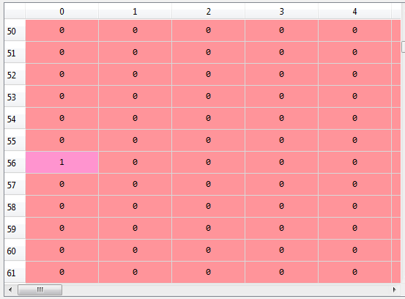
NLP Framework
Dataset
Collection of texts with categories (1, 0 etc.) to identify each with positive or negative feedbacks or reviews
LIBRARIES
import re: regular expression library
https://docs.python.org/2/library/re.html
import nltk: natural language toolkit
http://www.nltk.org/
REGEX Expressions
https://regex101.com/r/cJ2zT8/1
Data Cleaning
SUB: Remove all the text items superfluous and unnecessary from the dataset (i.e., everything unless letters a-z).
LOW: Also, to handle the texts to adapt it to needs (i.e., lower case and
Split
SPLIT: Create a splitted list with all the elements (words)
Stem
STOPWORDS: use the stopwords library to remove irrelevant words from the list
STEM: this is taking the meaningful root of the word, so loved becomes love.
The combination of stopwords and stemming gives place to my new list
JOIN
JOIN: after stemming and cleaning we do not need to work with lists more so we transform the lists to strings (sentences)
Corpus
CORPUS: list of lists. Each iteration has all the splits of one sentence. In our example it will contain all the 1000 cleaned reviews
Bag of words
The bag of words creates a matrix with one column for each word. In our example the table will contain 1000 rows (all the reviews) and 1500 columns (one by word). The column will tell how many times each word appears in the reviews
TOKENIZATION: process to take all the words of the review and create one column for each of them
SPARSE Metric
This is a matrix containing a lot of 0 values. When we work with machine learning models and NLP we try to reduce sparsity (number of 0’s) as much as we can

Slide 3
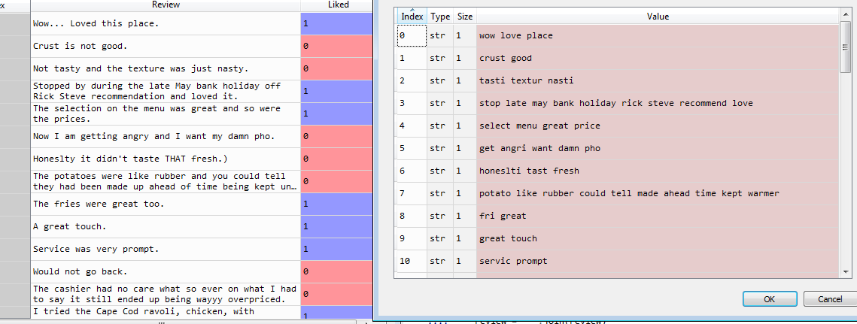
NLP Data Cleaning
Before Clean
After Clean

Slide 4
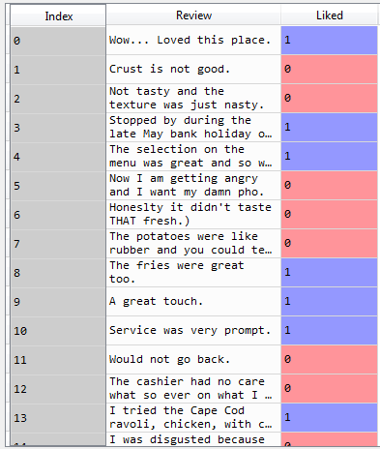
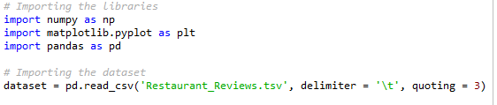
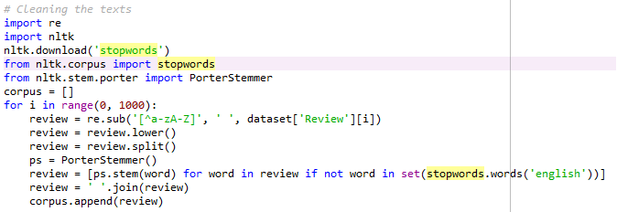

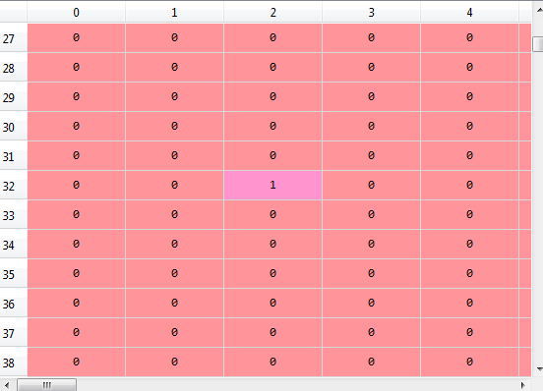
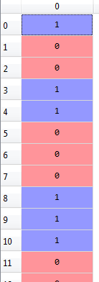





NLP
We are going to read a tsv (tab separated value) better than a csv because the text might include comas but not tabs.
The dataset provides us with 1000 reviews from a restaurant, pre-categorised as positive or negative (i.e. 1 or 0).
The plan is to train our algorithm with this dataset and then try in another test set to see if we can make accurate predictions
This algorithm might be used in other contexts such as:
Review the category of a book, newspaper etc.
Do text analytics in a text in internet etc.
Dataset
Download ‘stopwords’: 'stopwords' is a list of irrelevant words that we can omit\remove from our bag of words. We use the Natural Language toolkit to download the list
Clean the texts
review = re.sub('[^a-zA-Z]', ' ', dataset['Review'][i])
First thing we obtain a review (dataset[][i], and then transform the result by removing all the values that are not a-z or A-Z. That way we will remove all the superfluous data from our dataset (i.e., values like “:”,”…”,”-” etc.
Review.lower(), review.split(): To avoid misunderstandings transform the text to low letters and split the text
PorterStemmer: Generate a Stemmer class: it will be used to collect all combinations of one word
Stem every one of the words in the review (ps.stem(word)) and using the English language library
Join to turn the list of words again into cleaned and stemmed sentences
Corpus: end up adding the words in each iteration to a list of list, which is the corpus. Each row of the corpus will be a cleaned sentence
Create the bag of words
We can generate now a bag of words to simplify even further the resulting reviews list The bags of words is used to remove those words that appear rarely in the list.
Then, we have to train our algorithm with the dataset to understand the correlation between words and reviews.
Firstly, we are going to split the dataset between the corpus X (matrix with) with our bag of words (reviews and words) and y with the reviews only (1 or 0)
X
(1500x1000)
y
(1500x1)
Split training set and test set
NLP is basically a classification issue so we will chose a classification algorithm. In this particular case we have chosen Naïve Bayes
Fit Naïve Bayes to Training set
Predict the test set results
As usual, use the X_test dataset of 200 values to generate a Y_pred vector of predicted values
Confusion Matrix
Once completed, we can generate the confusion matrix to evaluate performance of our model
Our confusion matrix shows a total of 55 + 91 = 146 true positives/true negatives and 54 errors
Accuracy
We can calculate the accuracy of our model with the formula (FP +FN)/TOTAL

